Slide 1

TURNERS CARS PROPOSAL
Jade , Johnny, Freya

Slide 2

AN EMAIL THAT OUTLINES YOUR THOUGHT ON ETHICAL CONCERNS OF REPLACING AFTER-SALES STAFF WITH CHATBOTS, AND YOUR RECOMMENDATIONS TO THE MANAGER
- outlining OUR CONCERNS
- How WE AIM TO ADDRESS THESE CONCERNS

Slide 3
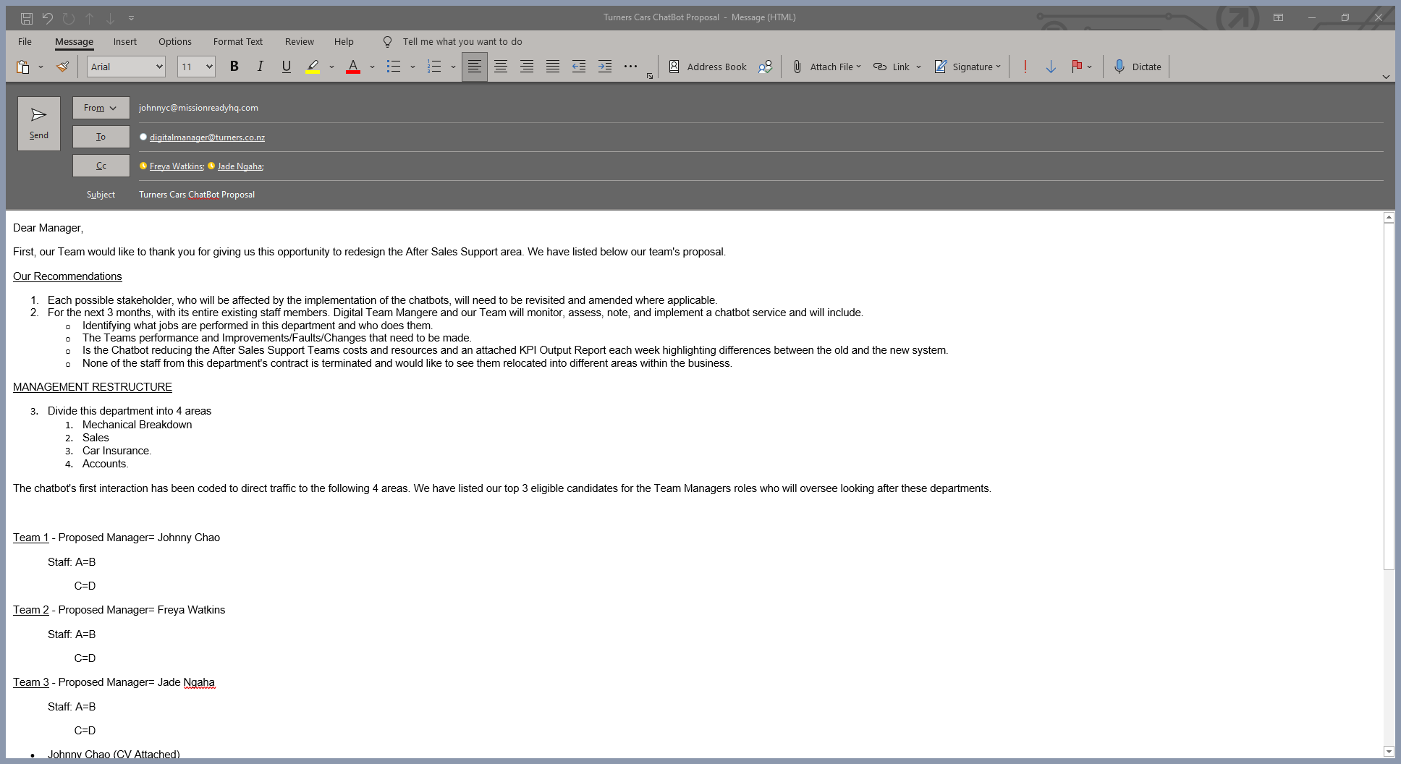

Slide 4
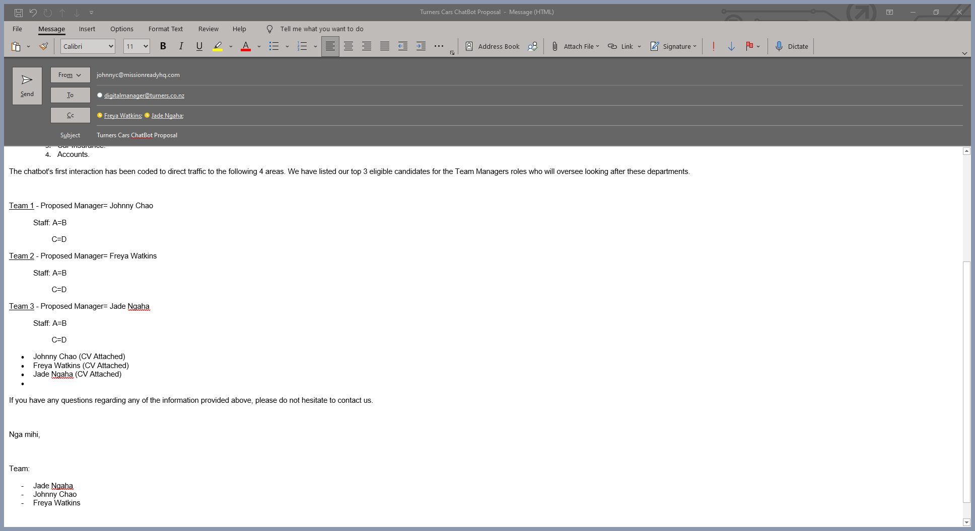

Slide 5
1) Contracts of staff affected must be re-assessed to protect staff interests. 2) Trial period of 3 months after implementation of the chatbot to monitor results. 3) Division of the department into 4 areas where traffic will be redirected by the chatbot to improve efficiency.
KEY RECOMMENDATIONS TO THE MANAGER

Slide 6
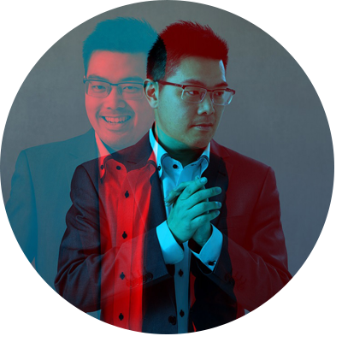
STAKEHOLDER LIST
- IDENTIFY A LIST OF STAKEHOLDERS YOU NEED TO INTERVIEW FOR THE MV INSURANCE REDESIGN PROJECT.

Slide 7
STAKEHOLDER IDENTIFICATION
CUSTOMERS
Does it provide the experience they expect / require?
Does it solve the problem they are wanting to have solved?
OWNERS
What impacts on the business does it have?
Will it improve sales?
Will it lower costs?
Will it impact the brand in a positive or negative way?
What will be the cost of implementation?
Will there be an impact of profit/share price?
COMPETITORS
What are our competitors doing?
Is there a reason they have or haven't done something?
Is there something they are doing that we can do differently/ better?

Slide 8
STAKEHOLDER IDENTIFICATION
EMPLOYEES
Will they lose jobs?
Will they need new of different skills?
GOVERNMENT
Is there a tax/regulation consideration?
SOCIETY
Will there be negative social impacts e.g., higher unemployment?
Will there be positive societal impacts e.g., increase skill level in work force, decrease insurance cost?
CREDITORS
Will this mean they will get paid on time/faster than normal?
Will it impact their ability to pay creditors?
INSURANCE GOVERNING BODIES – INSURANCE COUNCIL NZ
Do the new features meet the legislation requirements?

Slide 9
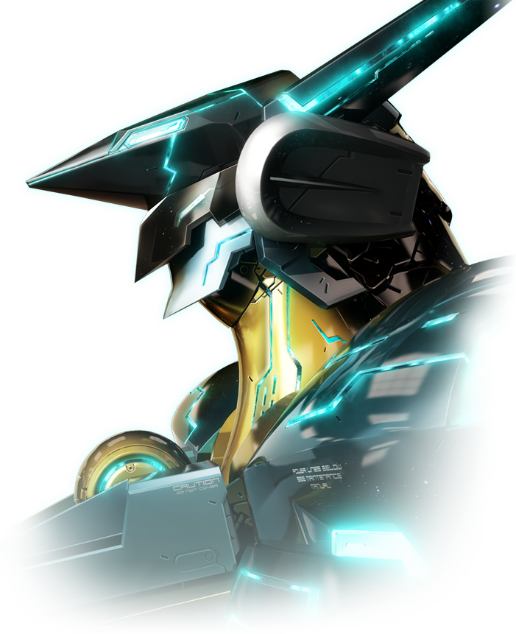
CHATBOT DESIGN
BUILD A PROTOTYPE CHATBOT THAT ANSWERS QUESTIONS ABOUT ONLINE AUCTIONS

Slide 10
PLANNING PHASE
Use of GitHub is prioritized for source code backup as well as team collaboration
An enthusiastic bot was needed so it can feel like a human experience.
Add a few silly quirks to it, so we can have a bot that is memorable and fun to interact with
Implement the FAQ from TurnersCars
Documentation of our sources for references

Slide 11
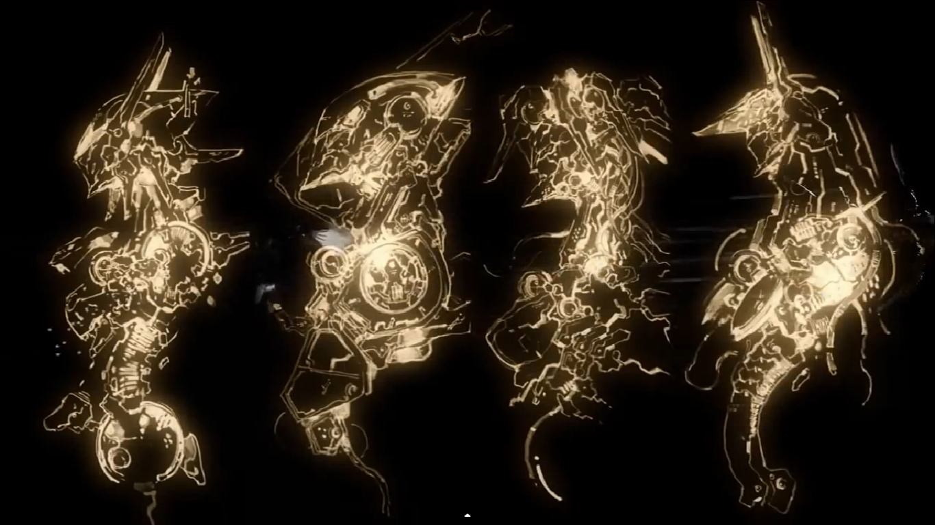
DEVELOPMENT AND TESTING PHASE
Necessary Research conducted
Implemented basic chat bot with various versions
Testing in a virtual environment
Pushed improved bot onto real environment and made changes if necessary

Slide 12
AZURE BOT DEMONSTRATION

Slide 13
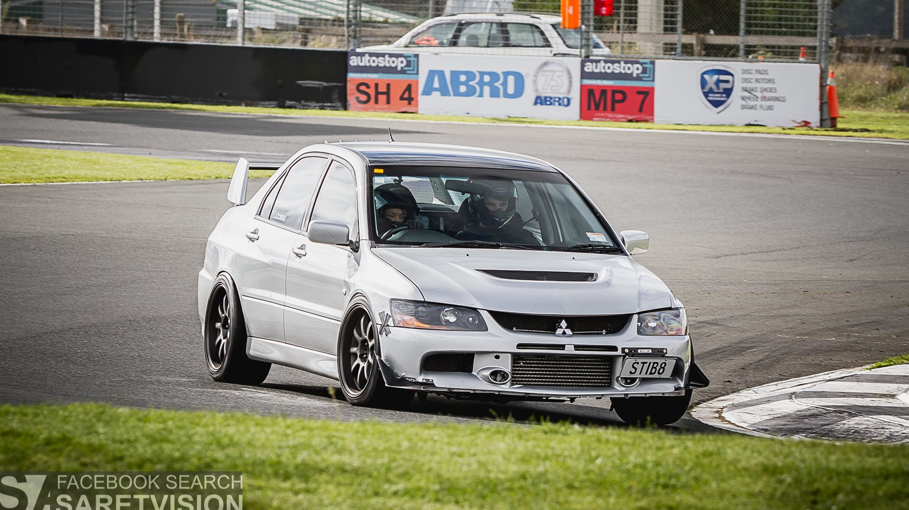
PROJECT SUMMARY AND QUESTIONS
THANK YOU

